Slide 1



Core Java
Core Java
Java I/O
Java I/O – Part 3
LEVEL – PRACTITIONER

Slide 2

Objectives
After completing this chapter you will be able to understand,
What is serialization in Java?
Significance of Transient Keyword.
A demo on Serialization and De-serialization.

Slide 3
One Day In a Software Development Project
One morning Tim a software developer of a retail store application received a call from customer stating that he was placing an order of 225 products from the retail store. On clicking the place order he got an error. He asked Tim to retrieve the 225 products he has entered and place the order. Tim analyzed the scenario and found out that there was a run time error before the data was stored. The customer had to key in all the 225 products again in the application.
Tim browsed the web and see if someone has faced this kind of problem and solved it in past? Voila! He saw a link where a solution was cracked?
Guess what the solution was?
The Solution was Serialization

Slide 4








How Tim solved the problem?
Tim implemented serialization in his application an technique which will persist the objects in the hard disk (or) transfer it to a different system.
Retail System
User orders products
Retail System Hard Disk
Retail Program
User
Program under crashes is developed to persist the products list in hard disk using serialization.
Program crashes when processing order.
Tim using the product list stored in the hard disk helped the customers to recover their data.

Slide 5
What is Serialization?
Serialization is technique used for saving the state of an object to a persistent storage area, such as a file and for transporting the objects across the network.
Some facts about serialization:
The objects stored can be restored by using the process of de-serialization.
Only an object that implements the Serializable interface can be persisted and restored by the serialization.
The Serializable interface defines no members. It is simply used to indicate that a class may be serialized.
If a class is serializable, all of its subclasses are also serializable.
Note: A interface with no methods is known as an abstract interface.

Slide 6
How to Serialize and de-serialize objects?
The following classes can be used for serializing and de-serializing an object.
ObjectOutputStream: Used for writing objects into the hard disk.
This has the method writeObject(targetobject) which used for persisting the serialized object to an output stream.
ObjectInputStream: This is used for reading the serialized object.
This has the method readObject() which can de-serialize a serialized object and load it back to memory.

Slide 7






Serialization Illustration
Going back to Tim’s scenario where he is trying to persist ProductInfo which holds the list of ordered products.
Retail System
Program serializes the ProductInfo into hard disk
User orders products
Retail System Hard Disk
Retail Program
De-Serializes the ProductInfo back into the java program.
User
Program crashes when processing order.

Slide 8
How can one prevent variables being de-serialized?
Transient keyword can be used to avoid serialization of instance variables.
Example: If productName is a instance variable in ProductInfo which should not be serialized it will be declared as,
Syntax: transient String productName;
The transient modifier applies only to instance variables.
Instance variables declared transient cannot be serialized.
If an instance variable is transient, java will not serialize the variable when the attempting to serialize the object .

Slide 9
Steps for Object Serialization
Step 1 : The class should implement Serializable interface make the object serializable.
Step 2 : Create an file (F) using the object FileOutStream class to store the serialized
object.
Step 3 : Create an object of the ObjectOutStream class to serialize the object and write into
the file (F) created as part of step 2.
Step 4 : Use the writeObject() method of the object stream class to save the object as a
serialized object in the file (F).

Slide 10
Steps for De-serialization
Step 1 : Create an object of the FileInputStream class for reading
the file (F).
Step 2 : Create an object of the ObjectInputStream class to read the
object from the file (F).
Step 3 : Use readObject() method on the ObjectInputStream
to read the object back into memory.

Slide 11
Lend a Hand – Object Serialization
Objective: Learn how to serialize objects.
Prerequisite: Create a Employee Object with employee Id, name, salary as instance variable.
Exercise: Develop methods to serialize in a file “data.txt” and de-serialize the employee objects. The salary should not be stored in the serialized file.
Create a class named SerializationDemo , develop a main method which should create a Employee object and serialize it.

Slide 12
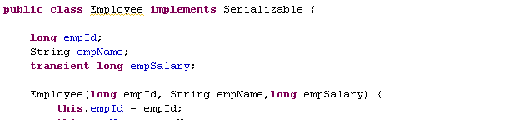
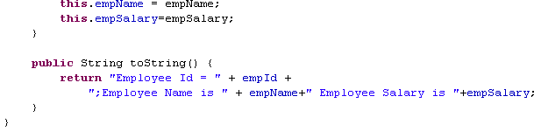
Lend A Hand - Solution
Implement serializable interface
Overriding the toString method to print the employee id , name and employee salary
Contd in next slide

Slide 13
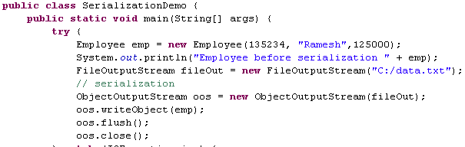
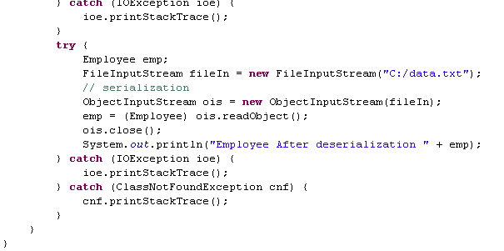
Lend A Hand - Solution
Serializing the Employee Object
De-Serializing the Employee Object

Slide 14
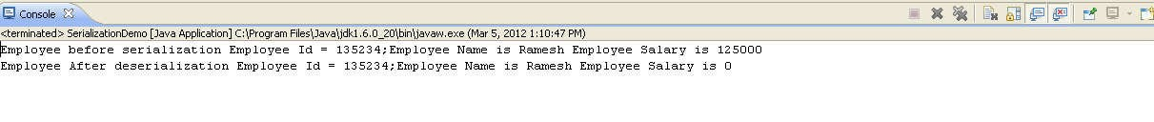

Output - Console
The following output will be shown on running the SerializationDemo class
Since the employee salary was declared as transient the value will not be persisted hence when the object is deserialized the value will be zero.

Slide 15
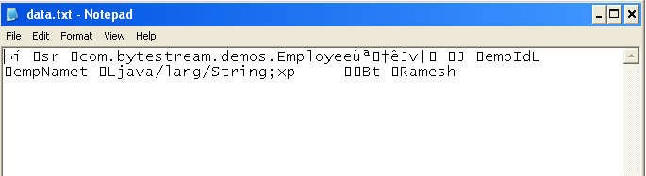

Persisted File Content

Slide 16


Core Java
You have successfully completed – Java I/O – Part 3

